Slide 1
CMSC 28100 Introduction to Complexity Theory Autumn 2025 Instructor: William Hoza
⏳

Slide 2
Course Review

Slide 3
Which problems can be solved through computation?

Slide 4
Strings and languages
$Σ^{∗}$ is the set of all strings over the alphabet $Σ$ (of any finite length)
A binary language is a subset $Y⊆{\{0, 1\}}^{∗}$
Corresponding problem: Given $w∈{\left\{0, 1\right\}}^{∗}$, figure out whether $w∈Y$
To study other types of problems, we can often formulate a closely related language
E.g., Exercise 14: Searching for large cliques

Slide 5
Which problems can be solved through computation?

Slide 6



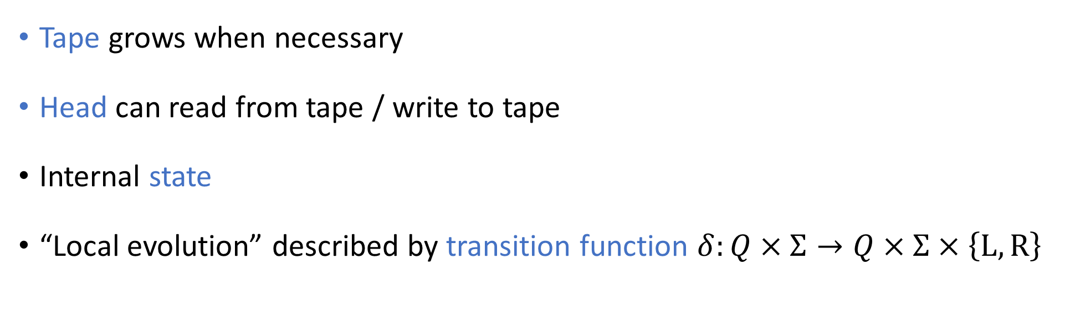



Turing machines
$$⊔$$
$$⊔$$
$$⊔$$
0
1
#
@
1
0
$$⊔$$
$$⊔$$
$$⊔$$
Tape grows when necessary
Head can read from tape / write to tape
Internal state
“Local evolution” described by transition function $δ:Q×Σ→Q×Σ×\left\{\text{L},\text{R}\right\}$

Slide 7
Which problems can be solved through computation?

Slide 8
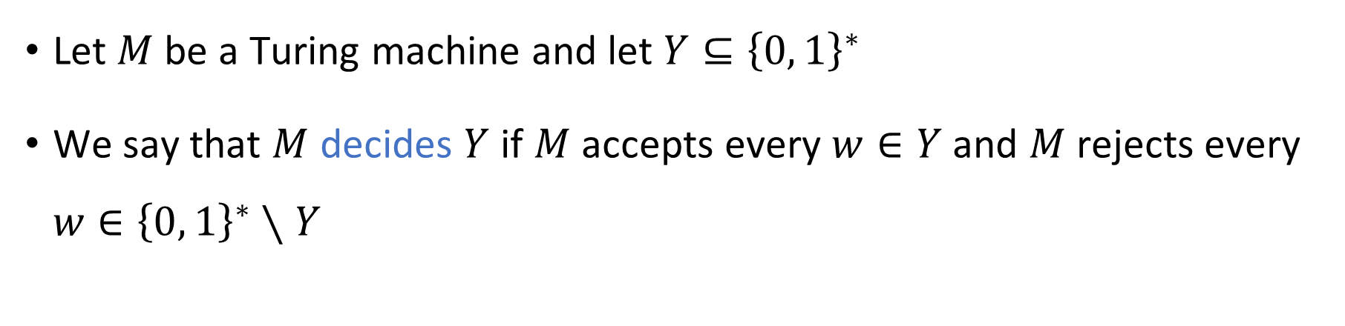
Deciding a language
Turing Machine
Accept
Reject
Run forever (“loop”)
Input
Let $M$ be a Turing machine and let $Y⊆{\left\{0, 1\right\}}^{∗}$
We say that $M$ decides $Y$ if $M$ accepts every $w∈Y$ and $M$ rejects every $w∈{\left\{0, 1\right\}}^{∗}∖Y$

Slide 9
The Church-Turing Thesis
Let $Y⊆{\left\{0, 1\right\}}^{∗}$
Church-Turing Thesis:
The problem of deciding whether a given string is in $Y$ can be “solved through computation” if and only if there is a Turing machine that decides $Y$.
Intuitive notion
Mathematically precise notion

Slide 10
The Physical Church-Turing Thesis
Let $Y⊆{\left\{0, 1\right\}}^{∗}$
Physical Church-Turing Thesis:
It is physically possible to build a device that decides $Y$ if and only if there is a Turing machine that decides $Y$.

Slide 11
Code as data
A Turing machine $M$ represents an algorithm
At the same time, $M$ can be encoded as a string $\left\langle M\right\rangle$
This string $\left\langle M\right\rangle$ could be the input or output of a different algorithm!

Slide 12
Universal Turing machines
Theorem: There exists a Turing machine $U$ such that for every Turing machine $M$ and every $w∈{\left\{0, 1\right\}}^{∗}$:
If $M$ accepts $w$, then $U$ accepts $⟨M,w⟩$.
If $M$ rejects $w$, then $U$ rejects $⟨M,w⟩$.
If $M$ loops on input $w$, then $U$ loops on $⟨M,w⟩$.

Slide 13

Universal Turing machines
If you are trying to build a computer from scratch, your job is to build a universal Turing machine
A universal Turing machine can be “programmed” to do anything that is computationally possible

Slide 14
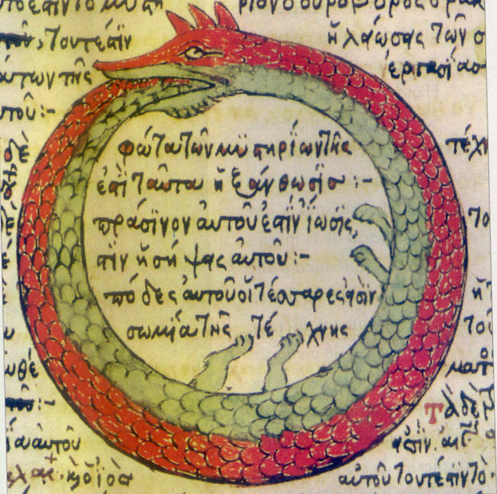

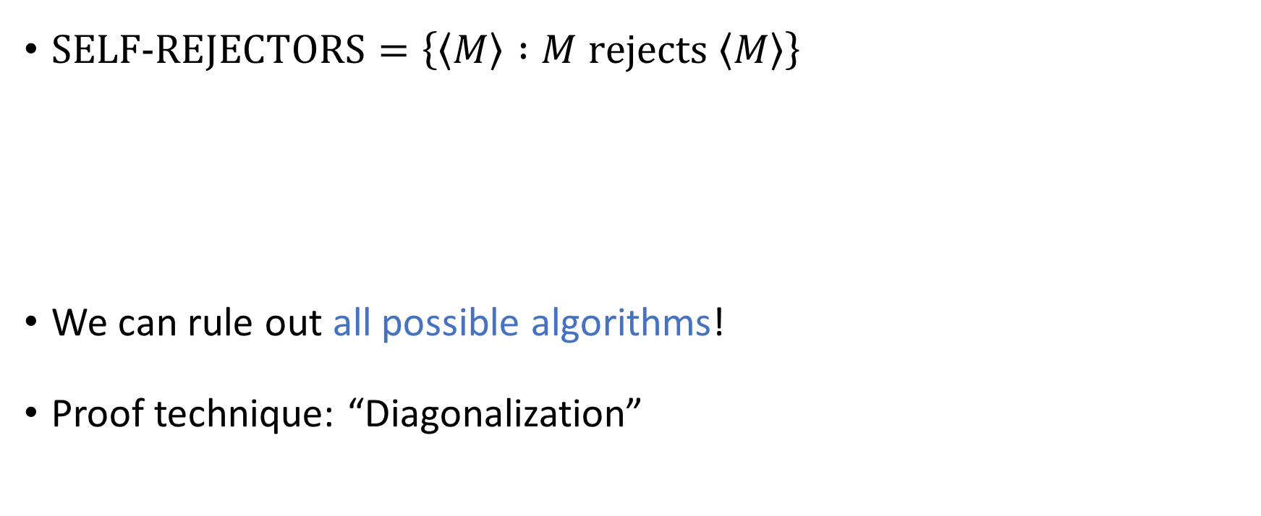
Undecidability
$\text{SELF}‑\text{REJECTORS}=\left\{\left\langle M\right\rangle :M \text{rejects} \left\langle M\right\rangle \right\}$
We can rule out all possible algorithms!
Proof technique: “Diagonalization”
Theorem: $\text{SELF}‑\text{REJECTORS}$ is undecidable

Slide 15



Reductions
To prove that $Y_{NEW}$ is undecidable:
Identify some known undecidable language $Y_{OLD}$
Assume for the sake of contradiction that $Y_{NEW}$ is decidable
Design an algorithm that decides $Y_{OLD}$, using hypothetical device deciding $Y_{NEW}$
Example: $\text{HALT}=\left\{\left\langle M,w\right\rangle :M \text{halts} \text{on} w\right\}$
?
Theorem: $\text{HALT}$ is undecidable

Slide 16
Post’s Correspondence Problem
Input: A set of “dominos”
Goal: Determine whether it is possible to generate a “match”
in which the sequence of top symbols equals the sequence of bottom symbols
$$\begin{matrix}t_{1} \\ b_{1}\end{matrix}$$
$$\begin{matrix}t_{2} \\ b_{2}\end{matrix}$$
$$\begin{matrix}t_{3} \\ b_{3}\end{matrix}$$
$$\begin{matrix}t_{k} \\ b_{k}\end{matrix}$$
$$⋯$$
$$\begin{matrix}t_{i_{1}} \\ b_{i_{1}}\end{matrix}$$
$$\begin{matrix}t_{i_{2}} \\ b_{i_{2}}\end{matrix}$$
$$\begin{matrix}t_{i_{3}} \\ b_{i_{3}}\end{matrix}$$
$$\begin{matrix}t_{i_{4}} \\ b_{i_{4}}\end{matrix}$$
$$\begin{matrix}t_{i_{5}} \\ b_{i_{5}}\end{matrix}$$
$$\begin{matrix}t_{i_{n}} \\ b_{i_{n}}\end{matrix}$$
$$⋯$$
Theorem: $\text{PCP}$ is undecidable

Slide 17
Asymptotic analysis
Notation | In words | Analogy
$T$ is $o\left(f\right)$ | $T\left(n\right)$ grows more slowly than $f\left(n\right)$ | $$<$$
$T$ is $O\left(f\right)$ | $T\left(n\right)$ is at most $c⋅f\left(n\right)$ | $$≤$$
$T$ is $Θ\left(f\right)$ | $T\left(n\right)$ and $f\left(n\right)$ grow at the same rate | $$=$$
$T$ is $Ω\left(f\right)$ | $T\left(n\right)$ is at least $c⋅f\left(n\right)$ | $$≥$$
$T$ is $ω\left(f\right)$ | $T\left(n\right)$ grows more quickly than $f\left(n\right)$ | $$>$$

Slide 18
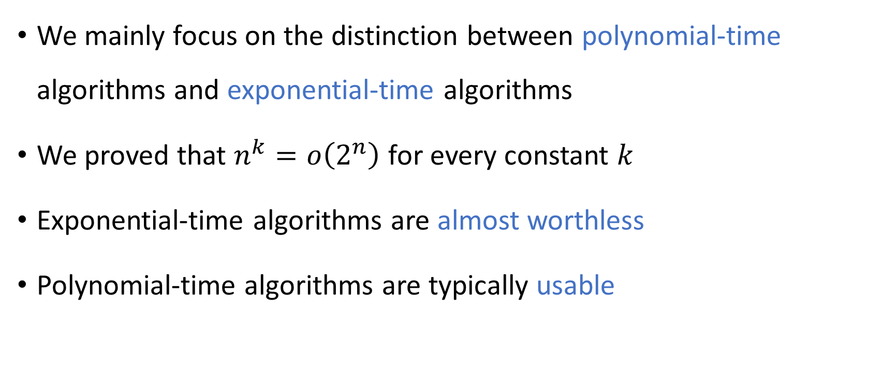
Polynomial-time computation
⏳
We mainly focus on the distinction between polynomial-time algorithms and exponential-time algorithms
We proved that $n^{k}=o\left(2^{n}\right)$ for every constant $k$
Exponential-time algorithms are almost worthless
Polynomial-time algorithms are typically usable

Slide 19
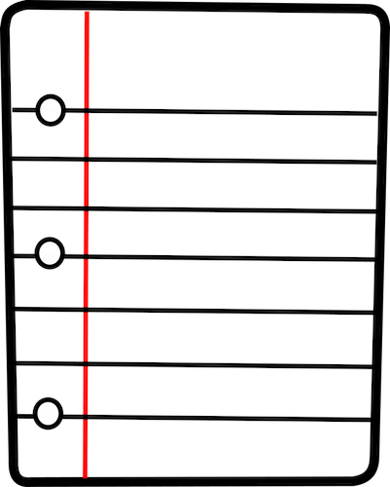

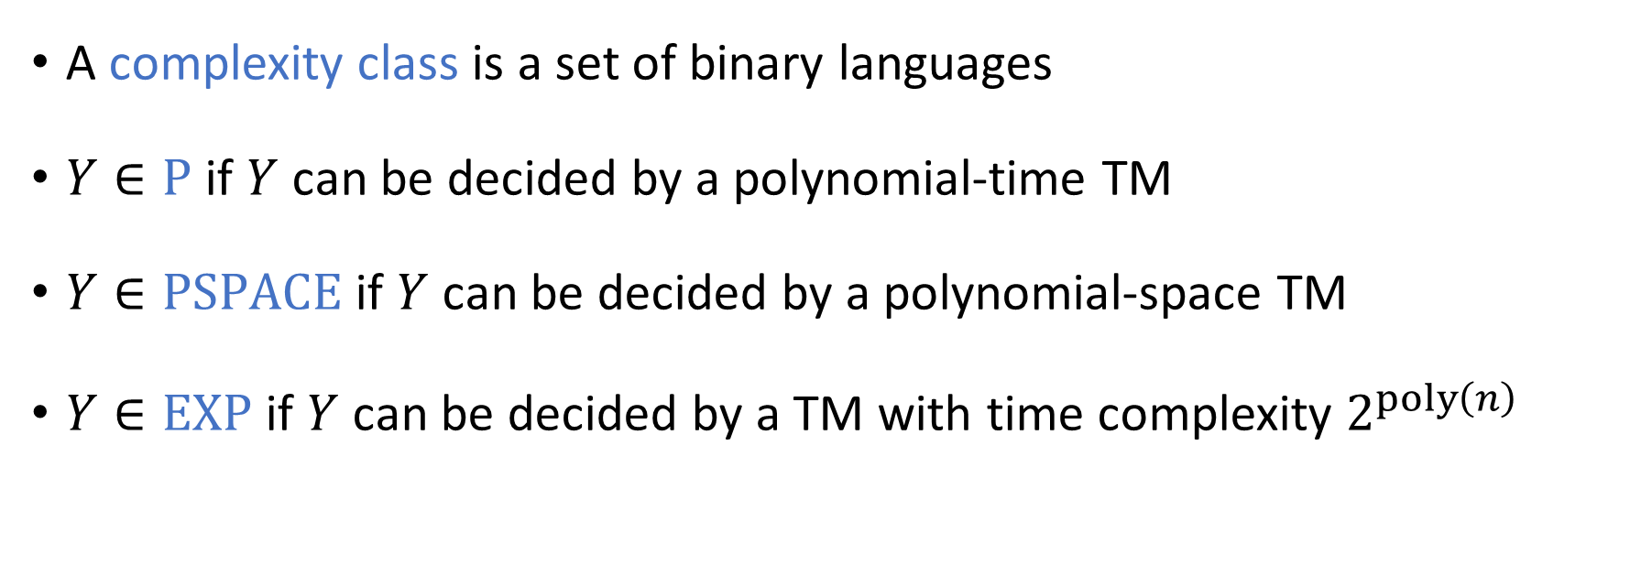
Complexity classes
⏳
A complexity class is a set of binary languages
$Y∈\text{P}$ if $Y$ can be decided by a polynomial-time TM
$Y∈\text{PSPACE}$ if $Y$ can be decided by a polynomial-space TM
$Y∈\text{EXP}$ if $Y$ can be decided by a TM with time complexity $2^{poly\left(n\right)}$

Slide 20
The Time Hierarchy Theorem
Let $T:ℕ→ℕ$ be any “reasonable” (time-constructible) function
Consequence: $\text{P}≠\text{EXP}$
Time Hierarchy Theorem: There is a language $Y∈\text{TIME}\left(T^{4}\right)$ such that $Y∉\text{TIME}\left(o\left(T\right)\right)$

Slide 21

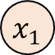



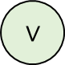
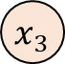
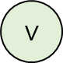
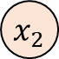

Boolean circuits
1
$$∨$$
A “circuit” is a network of binary logic gates applied to Boolean variables
$$∨$$
$$∧$$
$$∧$$
$$∧$$
$$⊕$$
$$⊕$$
$$x_{2}$$
$$x_{1}$$
$$x_{3}$$

Slide 22
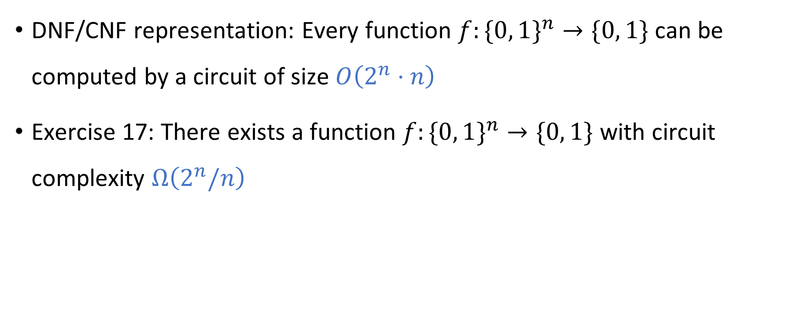
Circuit complexity
DNF/CNF representation: Every function $f:\{0, 1\}^{n}→\{0, 1\}$can be computed by a circuit of size $O\left(2^{n}⋅n\right)$
Exercise 17: There exists a function $f:\{0, 1\}^{n}→\{0, 1\}$ with circuit complexity $Ω\left(2^{n}/n\right)$

Slide 23
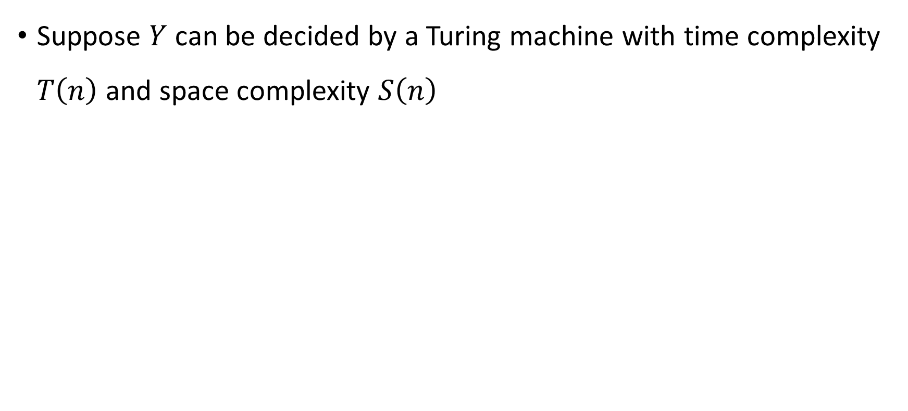

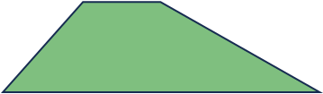

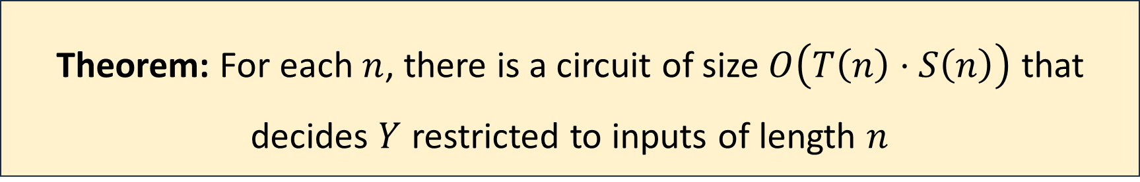
Turing machine $⇒$ circuits
Suppose $Y$ can be decided by a Turing machine with time complexity $T\left(n\right)$ and space complexity $S\left(n\right)$
Theorem: For each $n$, there is a circuit of size $O\left(T\left(n\right)⋅S\left(n\right)\right)$ that decides $Y$ restricted to inputs of length $n$

Slide 24

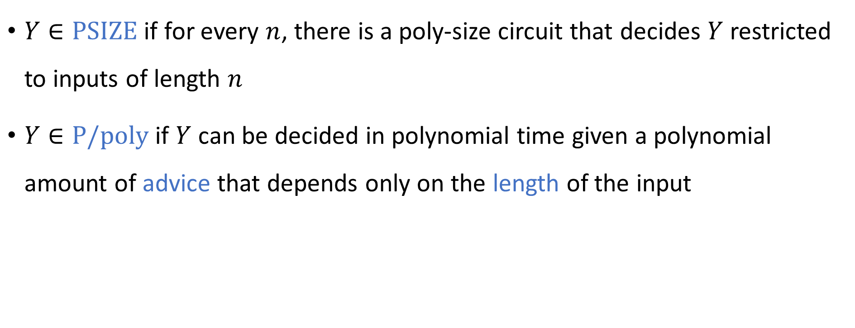


Circuits $⇔$ Computing with advice
$Y∈\text{PSIZE}$ if for every $n$, there is a poly-size circuit that decides $Y$ restricted to inputs of length $n$
$Y∈\text{P}/\text{poly}$ if $Y$ can be decided in polynomial time given a polynomial amount of advice that depends only on the length of the input
Theorem: $\text{PSIZE}=\text{P}/\text{poly}$

Slide 25


Randomized Turing machines
Input tape ➡
$$⊔$$
1
1
1
0
$$⊔$$
$$⊔$$
Randomness tape ➡
$$⊔$$

Slide 26
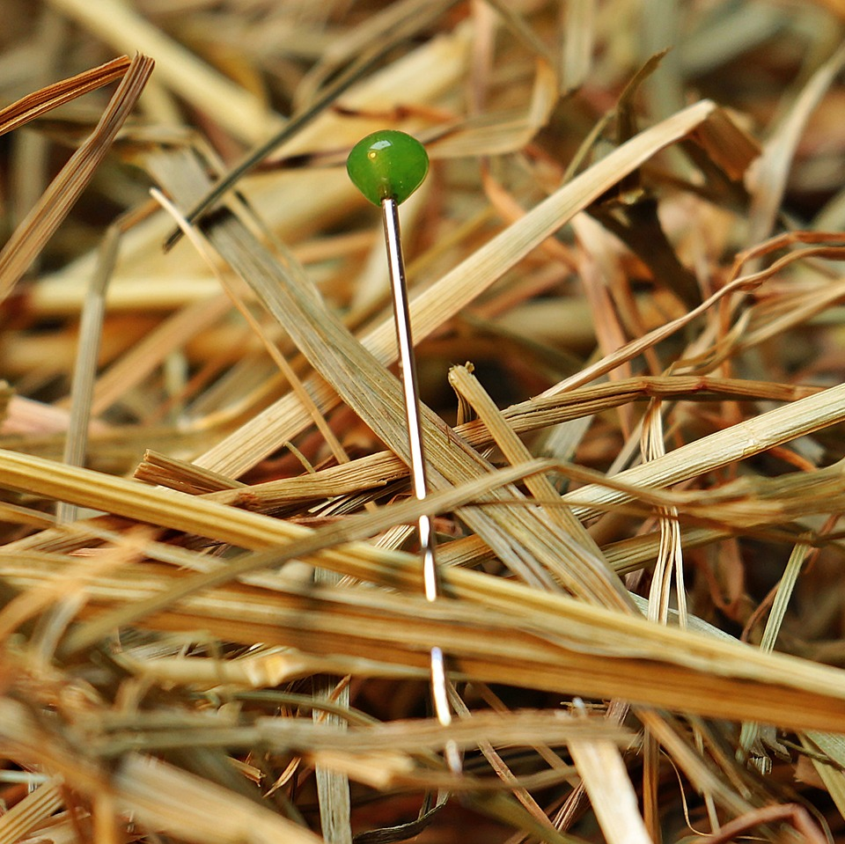
The complexity class $\text{NP}$
A language $Y$ is in $\text{NP}$ if there is a polynomial-time randomized Turing machine $M$ such that:
For every $w∈Y$, we have $\operatorname{Pr}\left[M \text{accepts} w\right]≠0$
For every $w∉Y$, we have $\operatorname{Pr}\left[M \text{accepts} w\right]=0$
Equivalent: Every $w∈Y$ has a certificate of membership, and certificates can be verified in (deterministic) polynomial time

Slide 27

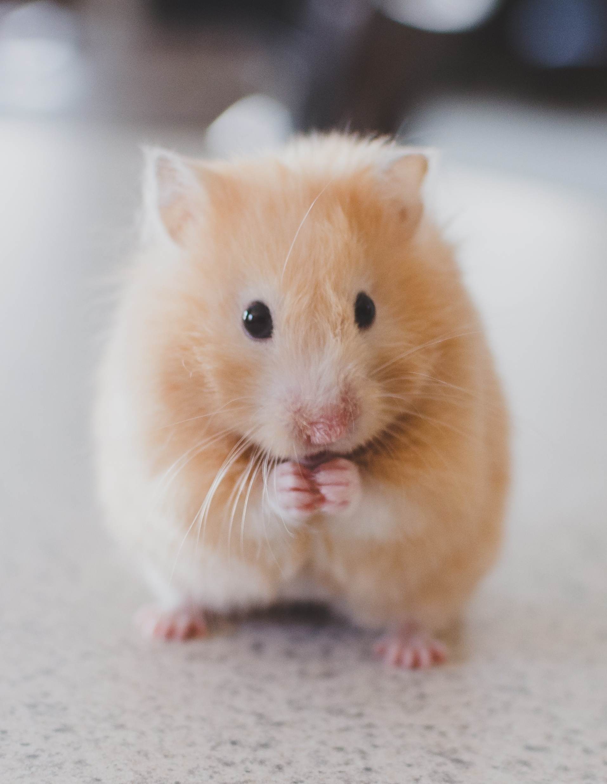
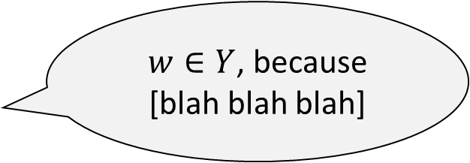
Prover and verifier
$w∈Y$, because [blah blah blah]
Accept/Reject
Prover (Computationally Unbounded)
Verifier (Polynomial Time)

Slide 28

The complexity class $\text{BPP}$
A language $Y$ is in $\text{BPP}$ if there is a polynomial-time randomized Turing machine $M$ such that:
For every $w∈Y$, we have $\operatorname{Pr}\left[M \text{accepts} w\right]≥2/3$
For every $w∉Y$, we have $\operatorname{Pr}\left[M \text{rejects} w\right]≥2/3$
Amplification Lemma: We can replace $2/3$ with $1−1/2^{n^{k}}$

Slide 29
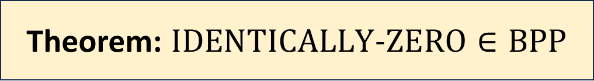
Example: Identity testing
$$×$$
Given: An arithmetic formula $F$
Goal: Figure out whether $F≡0$
Algorithm idea: Pick $\vec{x}$ at random and check whether $F\left(\vec{x}\right)=0$
$$+$$
$$+$$
$$x_{1}$$
$$×$$
$$x_{1}$$
$$x_{2}$$
Theorem: $\text{IDENTICALLY}‑\text{ZER}\text{O}∈\text{BPP}$
$$−1$$
$$x_{2}$$

Slide 30
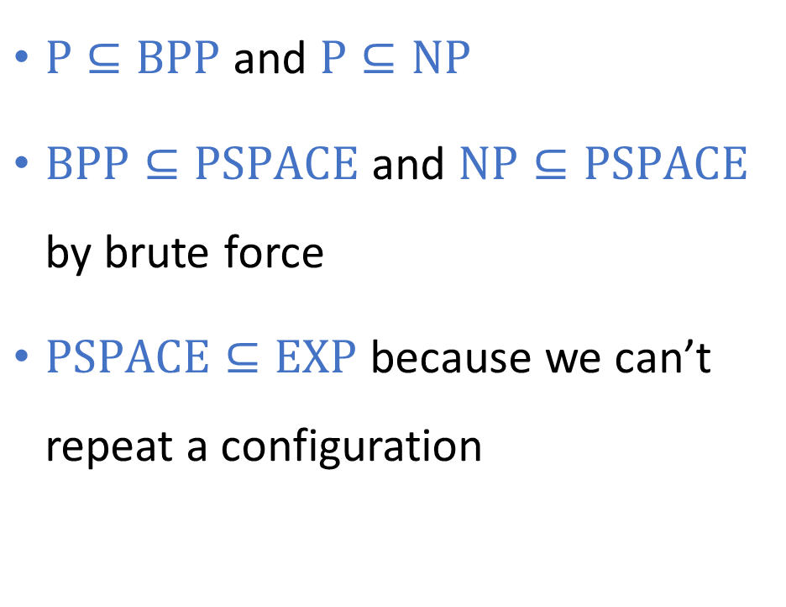
Complexity class inclusions
Decidable languages
$$\text{EXP}$$
$\text{P}⊆\text{BPP}$ and $\text{P}⊆\text{NP}$
$\text{BPP}⊆\text{PSPACE}$ and $\text{NP}⊆\text{PSPACE}$ by brute force
$\text{PSPACE}⊆\text{EXP}$ because we can’t repeat a configuration
$$\text{PSPACE}$$
$$\text{NP}$$
$$\text{P}$$

Slide 31
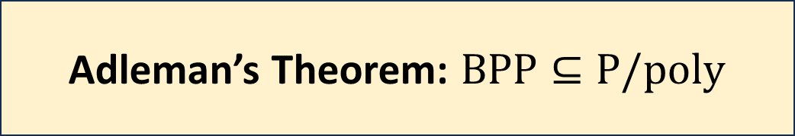

Adleman’s theorem
Adleman’s Theorem: $BP\text{P}⊆\text{P}/\text{poly}$
$$⇒$$

Slide 32
$\text{P}$ vs. $\text{BPP}$
To prove that certain problems are intractable, we need a mathematical model of tractability
$\text{P}$ and $\text{BPP}$ are both reasonable models of tractability
Which should we use?
Conjecture: $\text{P}=\text{BPP}$, so it’s a moot point

Slide 33

Extended Church-Turing Thesis
Extended Church-Turing Thesis:
For every $Y⊆{\left\{0, 1\right\}}^{∗}$, it is physically possible to build a device that decides $Y$ in polynomial time if and only if $Y∈\text{P}$.
The Extended Church-Turing Thesis is probably false because of quantum computing

Slide 34
Mapping reductions
$$Ψ$$
Let $Y_{1},Y_{2}⊆{\left\{0, 1\right\}}^{∗}$
Definition: $Y_{1}≤_{P}Y_{2}$ if there is a poly-time computable function $Ψ:{\left\{0, 1\right\}}^{∗}→{\left\{0, 1\right\}}^{∗}$ such that
$w∈Y_{1}⇒Ψ\left(w\right)∈Y_{2}$
$w∉Y_{1}⇒Ψ\left(w\right)∉Y_{2}$
$$Y_{2}$$
$$Y_{1}$$
$$Ψ$$
$${\left\{0, 1\right\}}^{∗}$$
$${\left\{0, 1\right\}}^{∗}$$

Slide 35
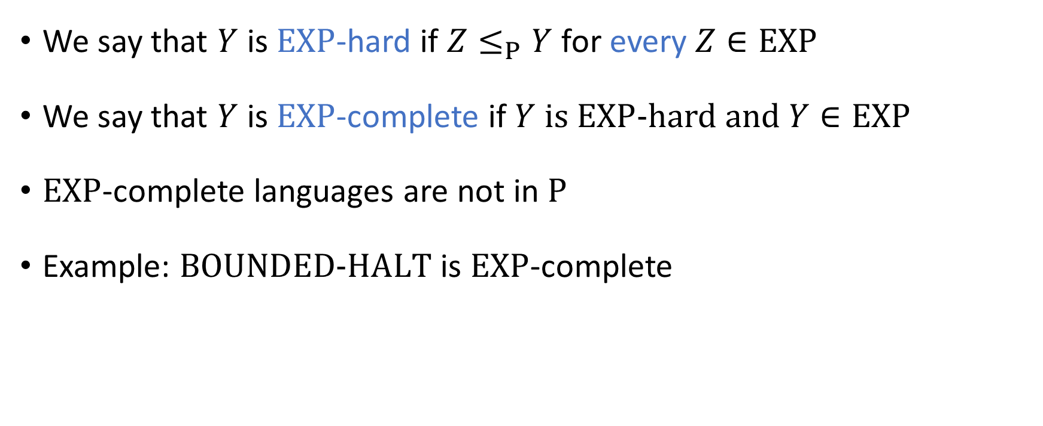
$\text{EXP}$-completeness
We say that $Y$ is $\text{EXP}$-hard if $Z≤_{P}Y$ for every $Z∈\text{EXP}$
We say that $Y$ is $\text{EXP}$-complete if $Y$ is $\text{EXP}$-hard and $Y∈\text{EXP}$
$\text{EXP}$-complete languages are not in $\text{P}$
Example: $\text{BOUNDED}\text{‑}\text{HALT}$ is $\text{EXP}$-complete

Slide 36
$\text{EXP}$-completeness
$\text{EXP}$-hard
$$\text{BOUNDED}\text{‑}\text{HALT}$$
$\text{EXP}$-complete
$$\text{EXP}$$
$$\text{P}$$

Slide 37
$\text{NP}$-completeness
$\text{NP}$-hard
A language $Y$ is $\text{NP}$-complete if $Y∈\text{NP}$ and $Z≤_{P}Y$ for every $Z∈\text{NP}$
$\text{NP}$-complete
$$\text{NP}$$
$$\text{P}$$

Slide 38
Circuit satisfiability
$\text{CIRCUIT}\text{‑}\text{SAT}=\left\{\left\langle C\right\rangle :C \text{is} \text{a} \text{satisfiable} \text{circuit}\right\}$
Theorem: $\text{CIRCUIT}\text{‑}\text{SAT}$ is $\text{NP}$-complete

Slide 39
The Cook-Levin Theorem
Definition: A $k$-CNF formula is an AND of ORs of at most $k$ literals
Definition: $k\text{‑}\text{SAT}=\{\left\langle φ\right\rangle :φ \text{is} \text{a} \text{satisfiable} k\text{‑}\text{CNF} \text{formula}\}$
The Cook-Levin Theorem: $3\text{‑}\text{SAT}$ is $\text{NP}$-complete

Slide 40
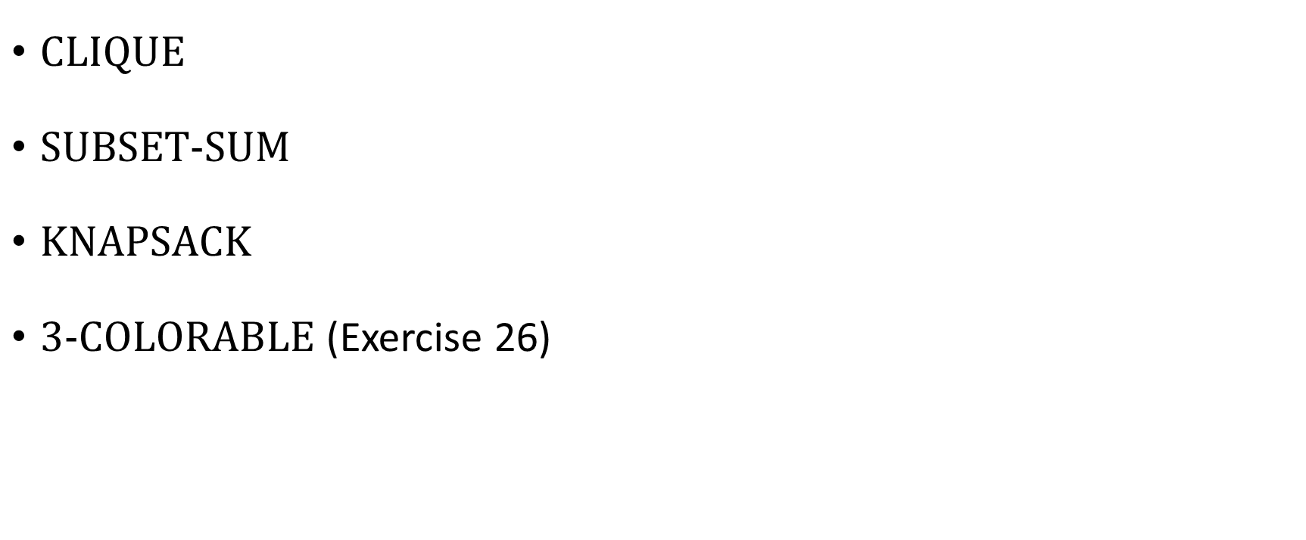
More $\text{NP}$-complete problems
$\text{CLIQUE}$
$\text{SUBSET}\text{‑}\text{SUM}$
$\text{KNAPSACK}$
$\text{3}\text{‑}\text{COLORABLE}$ (Exercise 26)

Slide 41
The $\text{P}$ vs. $\text{NP}$ problem
We conjecture that $\text{P}≠\text{NP}$: Solving and verifying are different
A proof that $\text{P}=\text{NP}$ would change the world
*Assuming the proof gives us truly practical algorithms
We could solve countless important problems in polynomial time 🙂
Hackers could break our encryption schemes in polynomial time 🙁

Slide 42
Approximation algorithms
We can find a “99% optimal” solution to a given instance of the knapsack problem in polynomial time 🙂
If $\text{P}≠\text{NP}$, then we cannot even find a “1% optimal” solution to a given instance of the clique problem in polynomial time ☹️

Slide 43
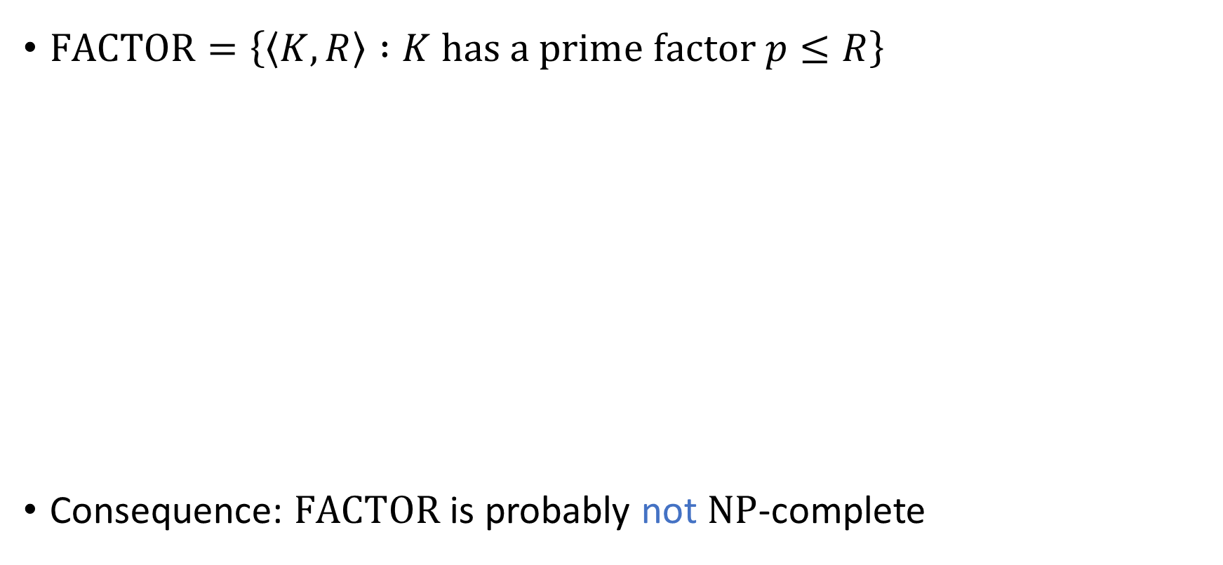
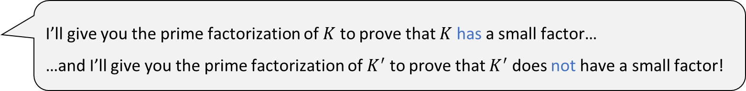
The complexity class $\text{NP}∩\text{coNP}$
$\text{FACTOR}=\left\{\left\langle K,R\right\rangle :K \text{has} \text{a} \text{prime} \text{factor} p≤R\right\}$
Consequence: $\text{FACTOR}$ is probably not $\text{NP}$-complete
Theorem: $\text{FACTOR}∈\text{NP}∩\text{coNP}$
I’ll give you the prime factorization of $K$ to prove that $K$ has a small factor…
…and I’ll give you the prime factorization of $K^{′}$ to prove that $K^{′}$ does not have a small factor!

Slide 44
$\text{coNP}$-hard
$\text{NP}$-hard
$\text{coNP}$-complete
$\text{NP}$-complete
$$\text{coNP}$$
$$\text{NP}$$
$$\text{FACTOR}$$
$$\text{NP}∩\text{coNP}$$
$$\text{P}$$

Slide 45
Thank you!
Teaching you has been a privilege
I hope you’ve enjoyed taking the course as much as I’ve enjoyed teaching it
Please fill out the College Course Feedback Form using My.UChicago (deadline is December 14)

Slide 46

Three big lessons
To study all possible algorithms, make a mathematical model of computation
Computation has severe, unavoidable limitations
Computer science is deep / profound / sublime
What is the nature of the physical universe?
What is the nature of the human condition?
See you at office hours and the final exam!
The End

